Slide 1
Research impact strategy
SoP staff meeting, 28th Feb 2024

Slide 2
What and why
‘an effect on, change or benefit to the economy, society, culture, public policy or services, health, the environment or quality of life, beyond academia’ (UKRI)
REF2021: 4 impact case studies (Andrade, Edworthy, Lloyd, and Pahl/Wyles)
Rated 3.5* ‘very considerable’ – ‘outstanding’
Awarded £1.8 million QR money for impact -> £259,184 per annum for 7 years -> £65k per ICS per year
Next REF: also an impact environment statement

Slide 3
How
Objectives to:
value and reward impact
support staff in identifying possible impact
build knowledge and skills relating to impact
facilitate interdisciplinary collaborations through PIHC and PIHR

Slide 4
Stage | How | Outcomes
Developing impact culture | Appointing impact lead with overview of impact potential in school Regular seminars and news bulletins related to impact Impact showcased on SoP webpages Impact covered in PDR meetings | Impact is visible Impact is valued Staff have good understanding of diverse routes to impact
Identification of impact potential | Regular encouragement to consider potential impact Impact lead has overview of staff research interests and proactively invites discussions about impact 1:1 support meetings with impact lead | Impact sessions and activities at staff away day Expanding pool of staff engaged in impact

Slide 5
Impact activity | Support networking with health and social care professionals, e.g., through PIHR and PIHC Support financially through strategic research funding Skills building and peer support through Research Impact Group Time in WAM for building impact case study Also time in WAM for impact activity that is not directly contributing to ICS | Staff feel that impact activities are valued and supported
Evidencing impact | Impact culture supported by annual impact report delivered at awayday or in writing Staff encouraged to document potential impact | Annual report on SoP impact Good records of impact evidence to support future case studies
Refining research questions | Impact discussions include how impact activities will feed back into research, to ensure research is applicable were appropriate and to reinforce that real-world application is part of the research process | Scientific research that gets attention because it has real-world implications Altmeter scores Press releases

Slide 6


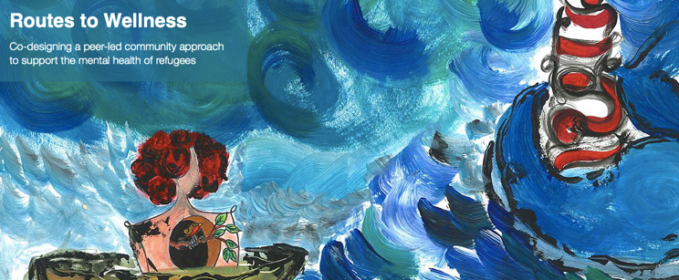
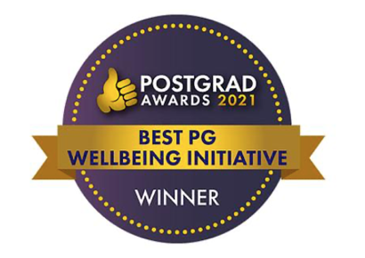

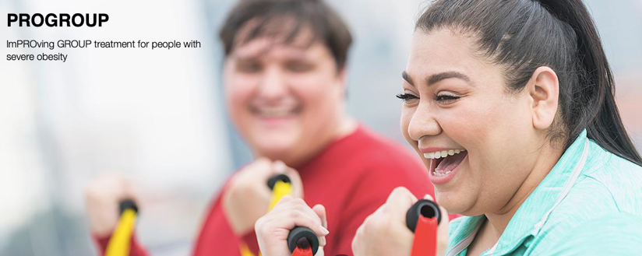


We have some excellent impact already developing
Potential for QR income and influencing UoP strategy for supporting impact
Comments welcome

